Slide 1


Marco Ramos
2024-05-27

Slide 2

Outline
Executive Summary
Introduction
Methodology
Results
Conclusion
Appendix

Slide 3
Executive Summary
Methodologies used in this project
Data collection, using web scrapping and SpaceX API;
Exploratory data analysis, using static and dynamic/interactive data visualizations;
Feature engineering, on selected features to process categorical variables;
Predictive analysis, building and testing different classification machine learning models;
Summary of all results
From all the features collected, the best were selected to be used for machine learning, which include Flight Number, Payload Mass, Flights, Block, Reused Count, Orbit, Launch Site, Landing Pad, Serial, Grid Fins, Reused, Reused, Legs;
After testing and tunning a decision tree classifier model was selected due to presenting the higher accuracy of the tested models;
Its possible to predict the success of a booster landing with the features available;

Slide 4
Introduction
A new rocket Company Space Y, founded by Billionaire industrialist Allon Musk would like to compete with SpaceX.
The main problem is predicting the cost of each launch and so, some questions were defined:
Can we determine if the first stage/booster will perform a successful landing?
Where is the best place to make launches?

Slide 5

Section 1

Slide 6
Methodology
Executive Summary
Data collection methodology:
Data from SpaceX was obtained from 2 sources:
SpaceX public API;
Web scrapping Wikipedia page about Falcon Rocket launches:
Perform data wrangling
Data after collection as analyzed and cleaned/formated by filtering unwanted launches related to old booster versions.
Perform exploratory data analysis (EDA) using visualization and SQL
Perform interactive visual analytics using Folium and Plotly Dash
Perform predictive analysis using classification models
How to build, tune, evaluate classification models

Slide 7
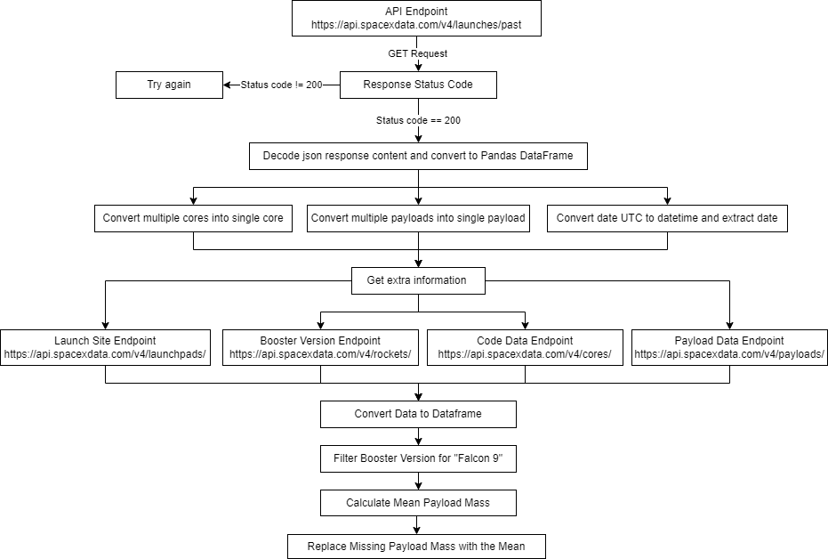
Data Collection – SpaceX API
Source Code: https://github.com/Majramos/coursera-applied-data-science-capstone/blob/main/assignments/jupyter-labs-spacex-data-collection-api.ipynb

Slide 8
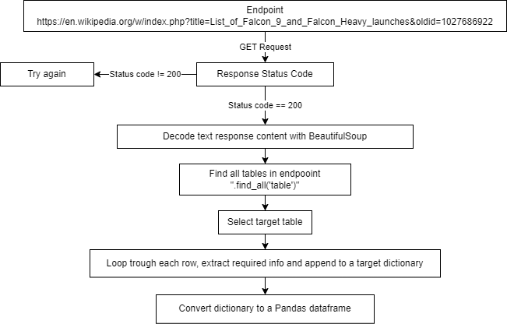
Data Collection - Scraping
Source Code: https://github.com/Majramos/coursera-applied-data-science-capstone/blob/main/assignments/jupyter-labs-webscraping.ipynb

Slide 9
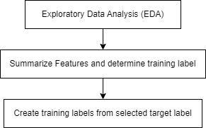
Data Wrangling
First Exploratory Data Analysis was performed on the dataset analyzing the launch sites, target orbits and launch outcomes.
Summarize some of the features and determine the training labels.
Create the training label (landing outcome) for the Outcome column.
Source Code: https://github.com/Majramos/coursera-applied-data-science-capstone/blob/main/assignments/labs-jupyter-spacex-Data%20wrangling.ipynb

Slide 10
EDA with Data Visualization
To perform EDA trough visualizations, the plot types were used:
Scatter plots;
Bar plots;
Line plots;
Features used for plotting:
Payload Mass
Flight Number
Launch Site
Orbit
Source Code: https://github.com/Majramos/coursera-applied-data-science-capstone/blob/main/assignments/jupyter-labs-eda-dataviz.ipynb

Slide 11
EDA with SQL
The names of the unique launch sites in the space mission;
5 records where launch sites begin with the string 'CCA’;
Total payload mass carried by boosters launched by NASA (CRS)
Average payload mass carried by booster version F9 v1.1;
Date when the first successful landing outcome in ground pad was achieved;
Names of the boosters which have successfully landed in drone ship and have payload mass greater than 4000 but less than 6000;
Total number of successful and failure mission outcomes;
Names of the booster versions which have carried the maximum payload mass;
Records which will display the month names, failure landing outcomes in drone ship, booster versions, launch site by month in year 2015;
Rank the count of landing outcomes (such as Failure (drone ship) or Success (ground pad)) between the date 2010-06-04 and 2017-03-20, in descending order;
Source Code: https://github.com/Majramos/coursera-applied-data-science-capstone/blob/main/assignments/jupyter-labs-eda-sql-coursera_sqllite.ipynb

Slide 12
Build an Interactive Map with Folium
An interactive map was created using Folium with markers, circles and lines used to represent the launch sites and other features around them
Markers indicate points like launch sites;
Circles indicate highlighted areas around specific coordinates, like NASA Johnson Space Center;
Marker clusters indicates groups of events in each coordinate, like launches in a launch site;
Lines are used to indicate distances between two coordinates, like between a launch site and nearest city, train line, etc;
Source Code: https://github.com/Majramos/coursera-applied-data-science-capstone/blob/main/assignments/lab_jupyter_launch_site_location.ipynb

Slide 13
Build a Dashboard with Plotly Dash
The following graphs and plots were used to visualize data:
Percentage of launches by site;
Percentage success launches by site;
Payload mass vs success launch vs booster version;
These interactive visualizations allowed to quickly analyze the success ratio by launch site and the relation between payloads mass and launch sites, helping to identify where is best place to launch.
Source Code: https://github.com/Majramos/coursera-applied-data-science-capstone/blob/main/assignments/spacex_dash_app.py

Slide 14
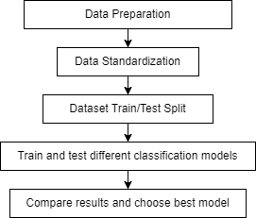
Predictive Analysis (Classification)
Dataset was prepared by:
Performing feature engineering by creating dummy variables from the categorical features
Applying standardization to the features;
The dataset was split in train and test dataset with choosing a test size of 20%;
4 different classification models were tested:
Logistic Regression;
Support Vector Machine;
Decision Tree Classifier;
K Nearest Neighbors;
The results were compared using 3 different metrics: accuracy, jaccard score and F1 score;
Source Code: https://github.com/Majramos/coursera-applied-data-science-capstone/blob/main/assignments/SpaceX_Machine_Learning_Prediction_Part_5.jupyterlite.ipynb

Slide 15
Results
Exploratory data analysis results
Space X uses 4 different launch sites;
The first launches were done to Space X itself and NASA;
The average payload of F9 v1.1 booster is 2,928 kg;
The first success landing outcome in a ground pad happened in 2015;
Many Falcon 9 booster versions were successful at landing in drone ships having payload above the average;
Only one mission outcome in 102 failed;
The booster version to carry the max payload until date was the F9 B5;
Payload mass and success ratio has been increasing with the number of flights/years;
VAFB-SLC launch site has no rockets launched for heavy payload mass (greater than 10000);
There are 4 target orbits with 100% success ratio (ES-L1, GEO, HEO, SSO);
The heaviest payloads were targeting VLEO orbit;

Slide 16
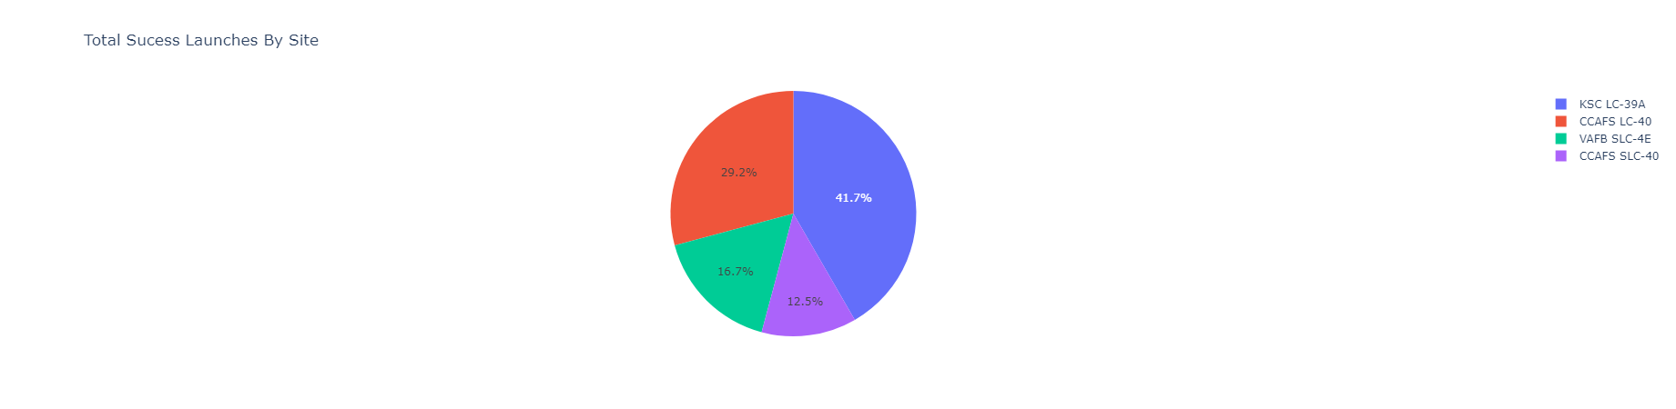
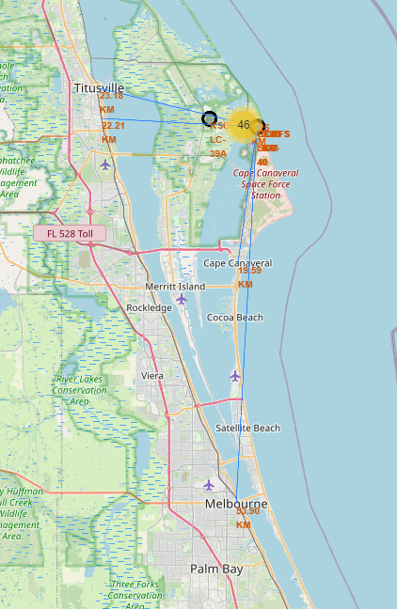
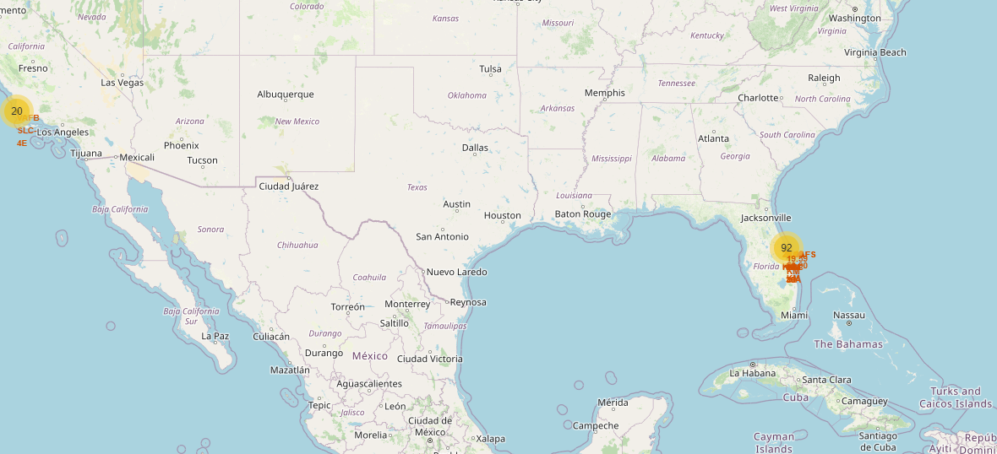
Results
Using interactive analytics, it was possible to identify the best launch site based on historical success ratio and proximity to required logistic infrastructure;

Slide 17
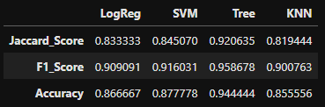
Results
Predictive analysis results showed that Decision Tree Classifier has the best results to predict successful landings, based on the F1 score of the model

Slide 18

Section 2

Slide 19
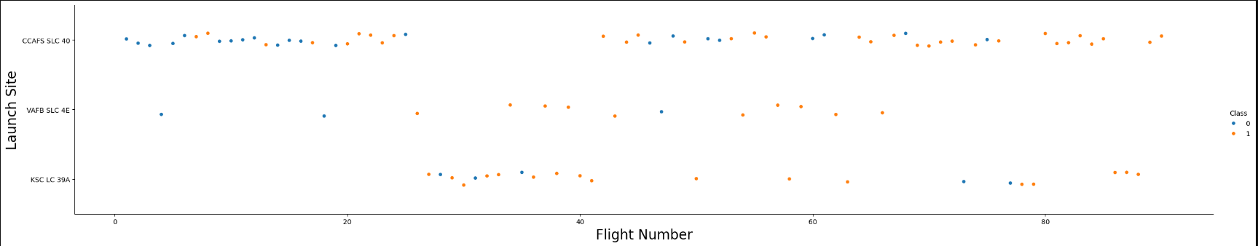
Flight Number vs. Launch Site
The general success rate increased with flight number time;
The site CCAFS SLC 40 has had the most launches overall;
All 3 sites had success booster landings in their last 5 launches;

Slide 20
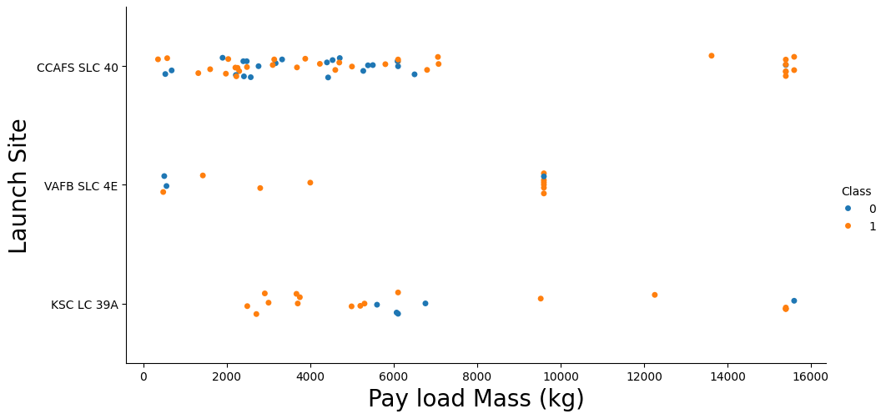
Payload vs. Launch Site
High payloads (over 9000kg) have high success ratio;
Launch site VAFB SLC 4E hasn’t launched payloads above 10000kg. Payloads over 12,000kg seems to be possible only on CCAFS SLC 40 and KSC LC 39A launch sites;

Slide 21
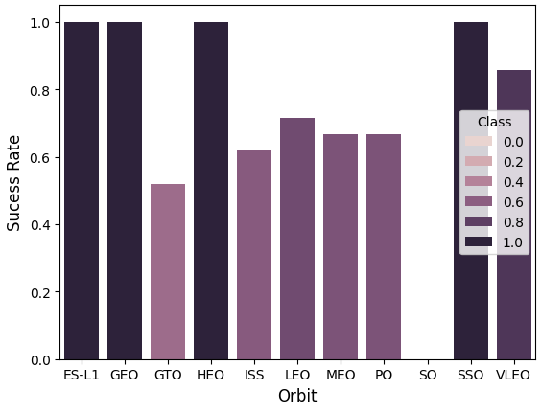
Success Rate vs. Orbit Type
Four orbits have 100% success rate: ES-L1, GEO, HEO, SSO;
One orbit, VLEO, with high success rate (above 80%,;
Orbits GTO, ISS, LEO, MEO, PO have moderate success rate (between 50% and 80%);
One orbit, SO, never had a successful booster recover;

Slide 22
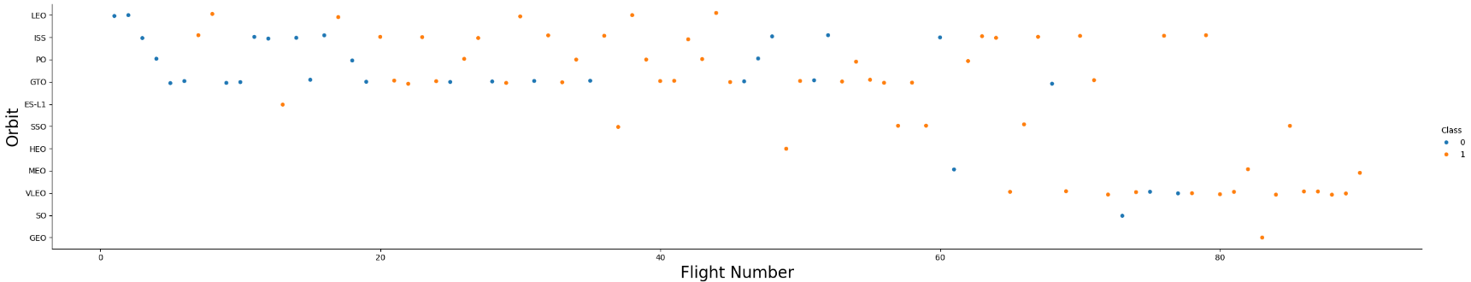
Flight Number vs. Orbit Type
GEO orbit only with one recent and successful launch;
MEO, VLEO, SO, GEO are all recently targeted orbits with apparently successfully launches;

Slide 23
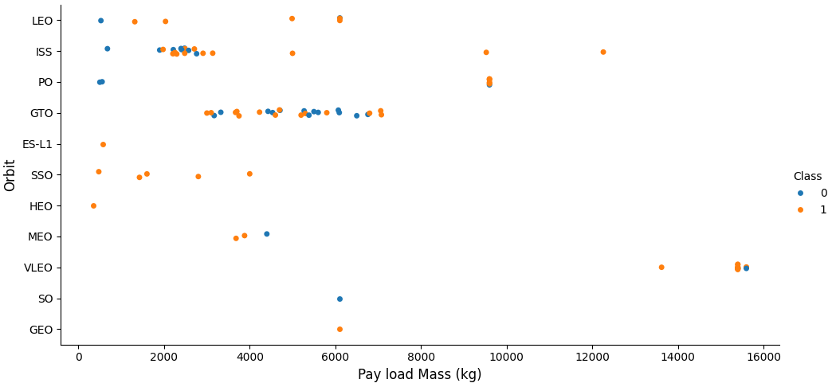
Payload vs. Orbit Type
Only the VLEO orbit has received high payload masses;
Orbits ES-L1, SSO, HEO have 100% success rate with low payload;
No apparent relation between payload and success rate to orbit GTO;
ISS orbit has the widest range of payload and a good rate of success masses;
There are few launches to the orbits SO and GEO;

Slide 24
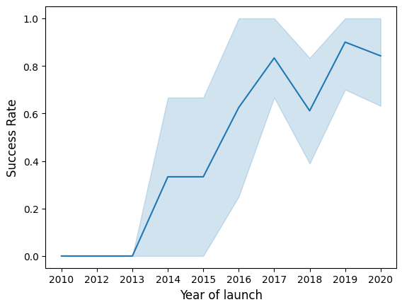
Launch Success Yearly Trend
Success rate since 2013 kept increasing till 2017
It stayed stable in 2014;
After 2015 it started increasing until 2017;
In 2017 there was a decrease in the success ratio, but by the end of 2019 it had recover;
2019 seems to be the year with the highest observed success ratio;

Slide 25
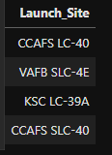
All Launch Site Names
All launch site names were obtained by selecting the distinct values of “Launch_Site” from the dataset;
Only 4 launch sites available in the dataset;

Slide 26
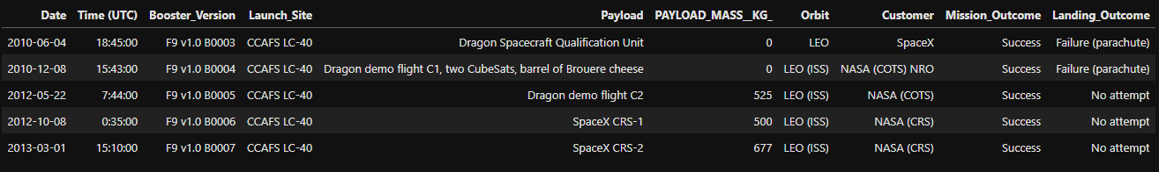
Launch Site Names Begin with 'CCA'
The 5 records were selected by filtering the field “Launch_site” starting by the string ‘CCA’ using a wildcard ‘CCA%’;
Launch site beginning with CCA refer to the CCAFS LC-40 launch site;
The first 5 records for launch site CCAFS LC-40 were all using booster versions F9 v1.0, all with successful mission outcome and no recovery of booster;

Slide 27
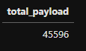
Total Payload Mass
The total payload mass carried by boosters launched by NASA (CRS) was obtained trough the sum of the payload mass (PAYLOAD_MASS__KG_, renamed to total_payload) where the “Customer” is equal to ‘NASA CRS’;

Slide 28
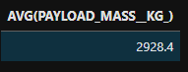
Average Payload Mass by F9 v1.1
The average payload mass carried by boosters of version F9 v1.1 was obtained trough the avg of the payload mass (PAYLOAD_MASS__KG_) where the “Booster_Version” is equal to ‘F9 v1.1’;

Slide 29
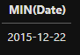
First Successful Ground Landing Date
The first date of a success landing in a ground pad was obtained trough the minimum value of “Date” were the “Landing_Outcome” is equal ‘Success (ground pad)’;

Slide 30
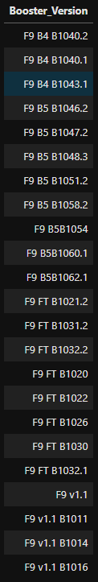
Successful Drone Ship Landing with Payload between 4000 and 6000
The distinct values of “Booster_Version” were selected by selecting where “PAYLOAD_MASS__KG_” larger than 4000 and less than 6000;

Slide 31
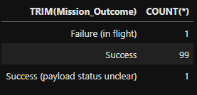
Total Number of Successful and Failure Mission Outcomes
The total number of successful and failure mission outcomes was obtained by grouping mission outcomes and counting records/rows for each group;

Slide 32
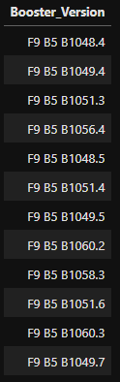
Boosters Carried Maximum Payload
The list of booster names which carried the maximum payload were obtained by selecting the distinct values of “Booster_Version” where the payload mass given by the field “PAYLOAD_MASS__KG_” is equal to the maximum values of “PAYLOAD_MASS__KG_”;

Slide 33
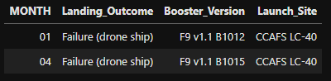
2015 Launch Records
The failed landing_outcomes in drone ship, their booster versions, and launch site names for in year 2015 were obtained by selecting the features “Landing_Outcome”, “Booster_Version”, “Launch_Site” filtering where the first 4 characters of “Date” are equal to ‘’2015’ and “Landing_Outcome” is equal to ‘Failure (drone ship)’;

Slide 34
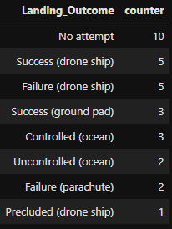
Rank Landing Outcomes Between 2010-06-04 and 2017-03-20
To get the rank of the count of landing outcomes (such as Failure (drone ship) or Success (ground pad)) between the date 2010-06-04 and 2017-03-20, in descending order, one grouped landing outcomes and counted records/rows for each group while filtering “Date” between ‘2010-06-04’ and ‘2017-03-20’ ordering the results by the count of rows of each group;

Slide 35

Section 3

Slide 36
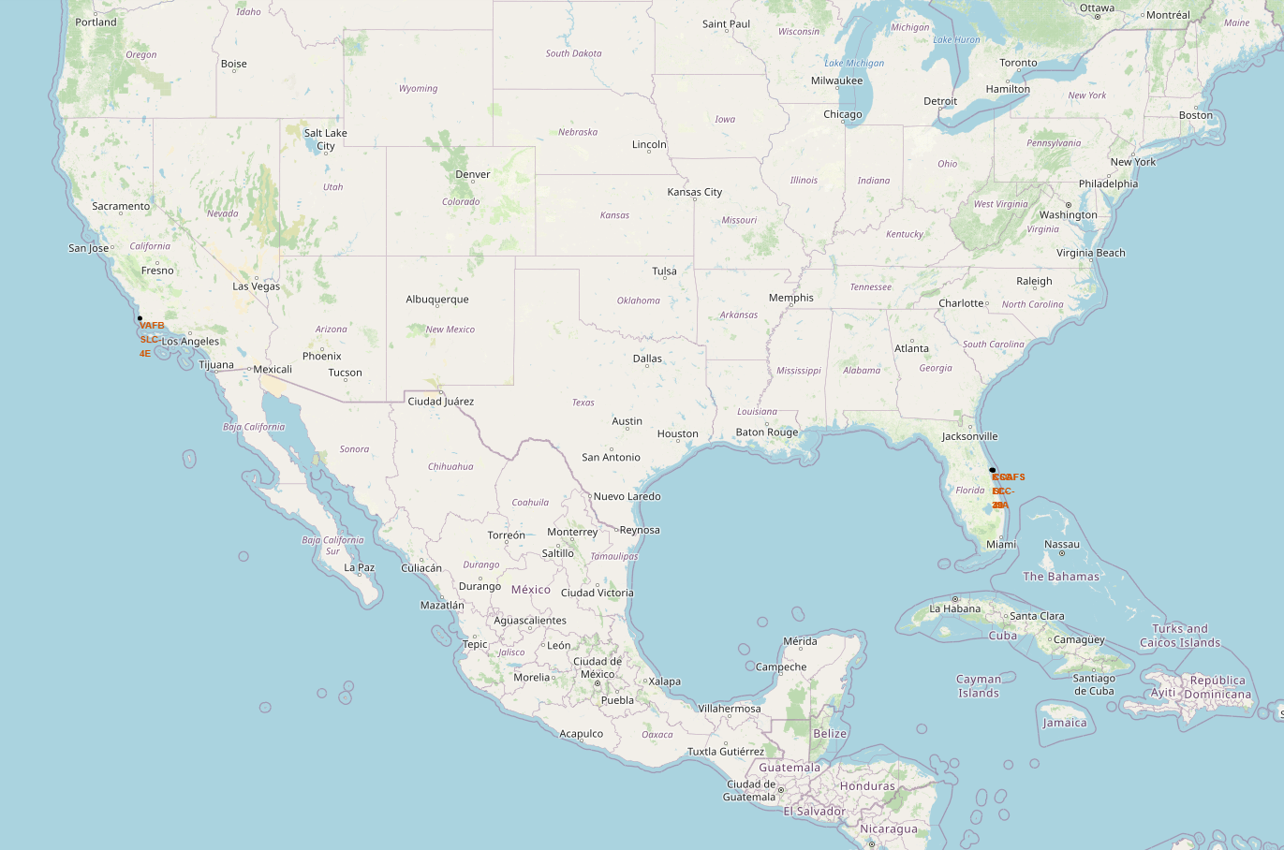
All launch sites
All the launch sites are close to the ocean, far from cities and as south as possible in the United States America;

Slide 37
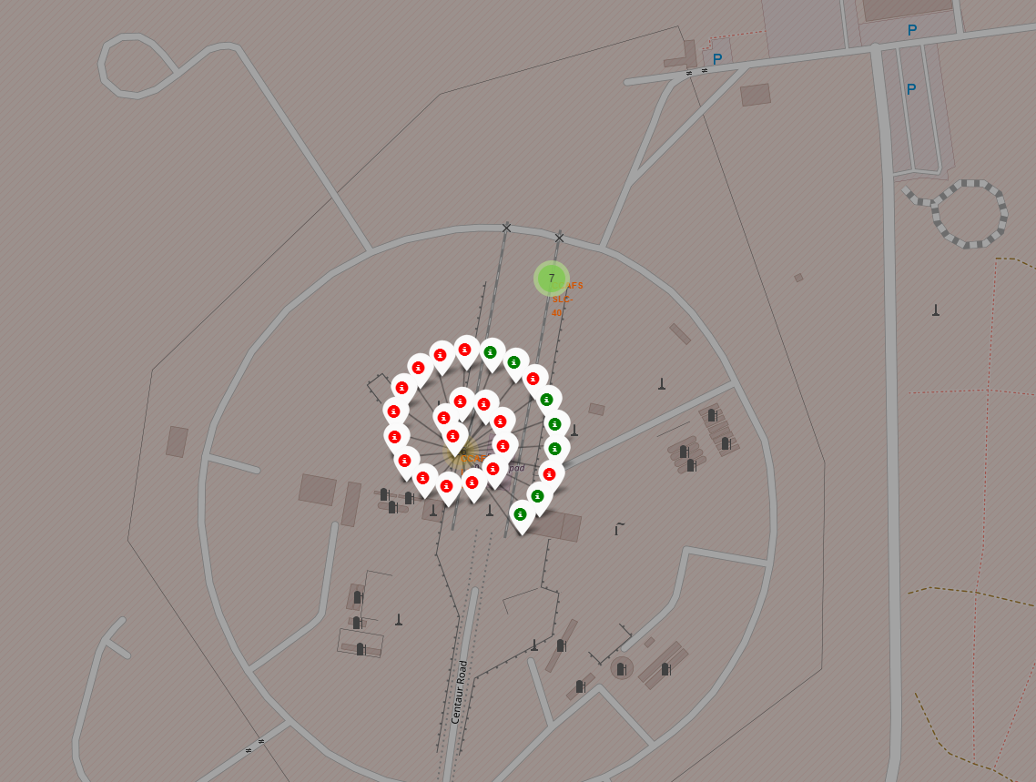
Launch Outcomes by Site
Green markers indicate successful and red ones indicate failure;

Slide 38
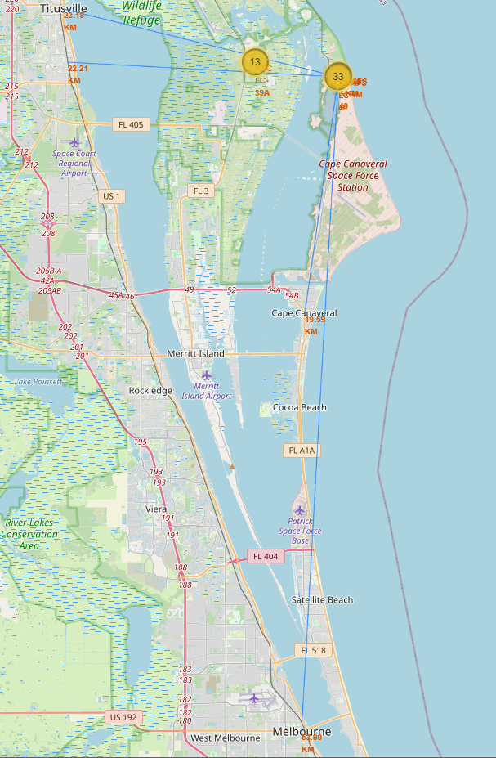
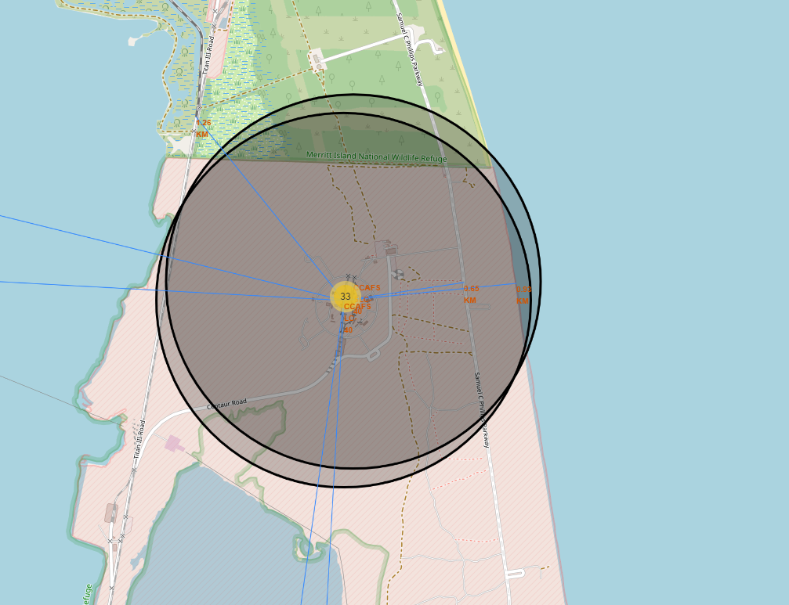
Logistics and Safety
Launch sites at the Cape Canaveral Space Force Station present a good distance to utilities like roads and train and enough distance to cities;

Slide 39

Section 4

Slide 40
Successful Launches by Site
The launch site with the most success launches is KSC LC-39A with 41.7% of all the successful launches.

Slide 41
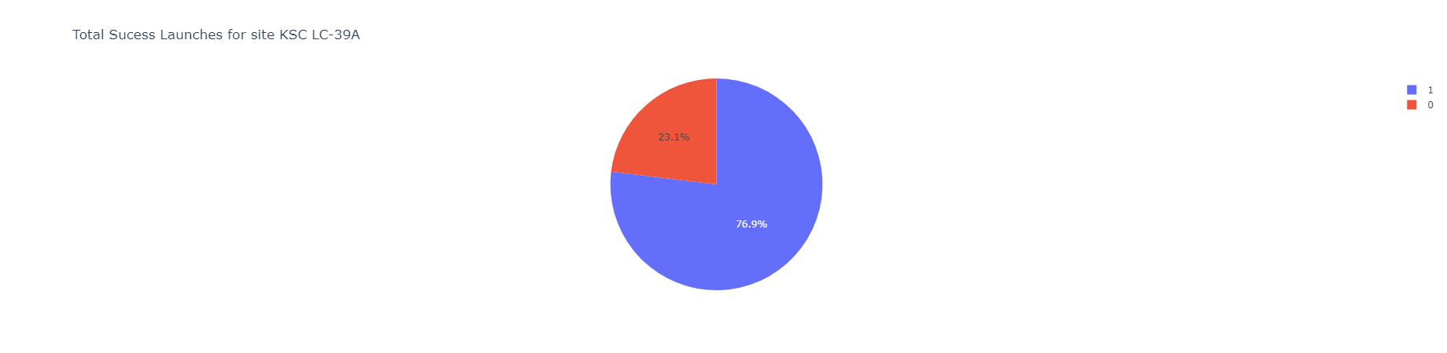
Launch Success Ratio for KSC-39A
The site KSC LC-39A has a launch success ratio of 76.9%;

Slide 42
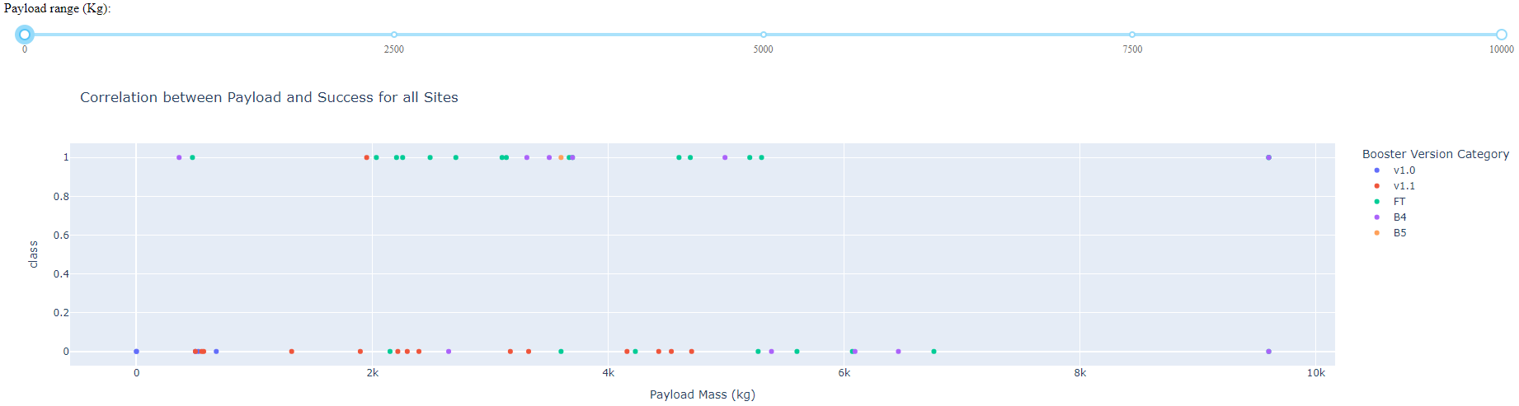
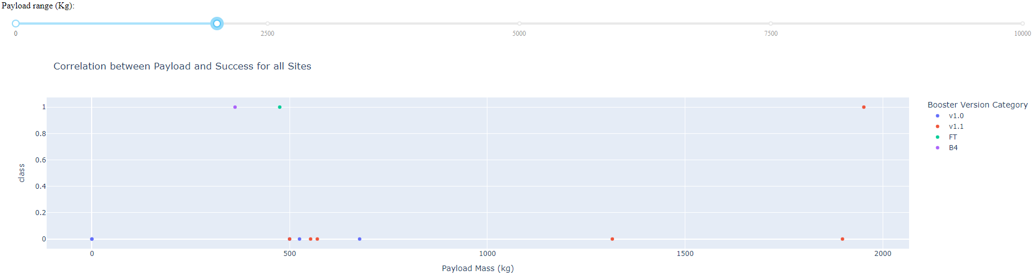
Payload vs. Launch Outcome vs. Booster Version
Versions v1.0 and v1.1 have low payload launches and success ratio;
For booster version B5, only have one point with a successful launch;
With lower payload mass, more recent booster versions and a high success ratio;

Slide 43
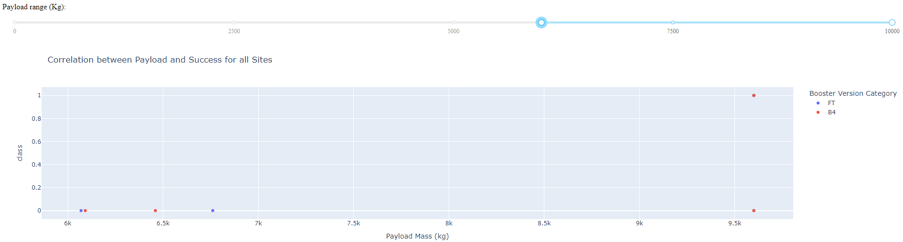
Payload vs. Launch Outcome vs. Booster Version
Both FT and B4 had a success and fail launch with payload higher than 7000kg making impossible with only these two variables make proper predictions to high mass payloads;

Slide 44

Section 5

Slide 45
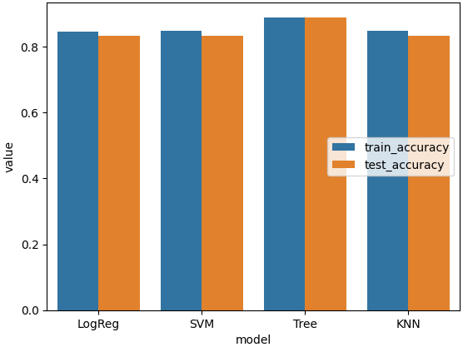
Classification Accuracy
The best model is the decision tree classifier due to obtaining highest accuracy no only in the train dataset but also in the test dataset;

Slide 46
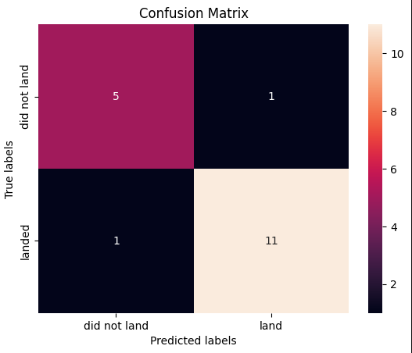
Confusion Matrix
The confusion matrix for the decision tree classifier showed only one false negative and one false positive;

Slide 47
Conclusions
Different data sources were analyzed, refining conclusions along the process;
The site KSC LC-39A based on historic successes and proximity to utilities, presents itself as the best location for launches;
Launches with high payloads masses present an apparent higher success ratio, but it could be biased due to high payloads only happened in more recent flights;
Although most of mission outcomes are successful, successful landing outcomes seem to improve over time, according the evolution of processes and rockets;
Decision Tree Classifier can be used to predict booster landings success and thus increase profits;

Slide 48
Appendix
Include any relevant assets like Python code snippets, SQL queries, charts, Notebook outputs, or data sets that you may have created during this project

Slide 49


